Slide 1
PHYS 221 Recitation
Kevin Ralphs
Geometric Optics

Slide 2
Geometric Optics
What is it?
Geometric optics is an approximation scheme that allows us to approximate light as rays
Applicable when the wavelength of light is very small compared to the objects and features with which it is interacting

Slide 3
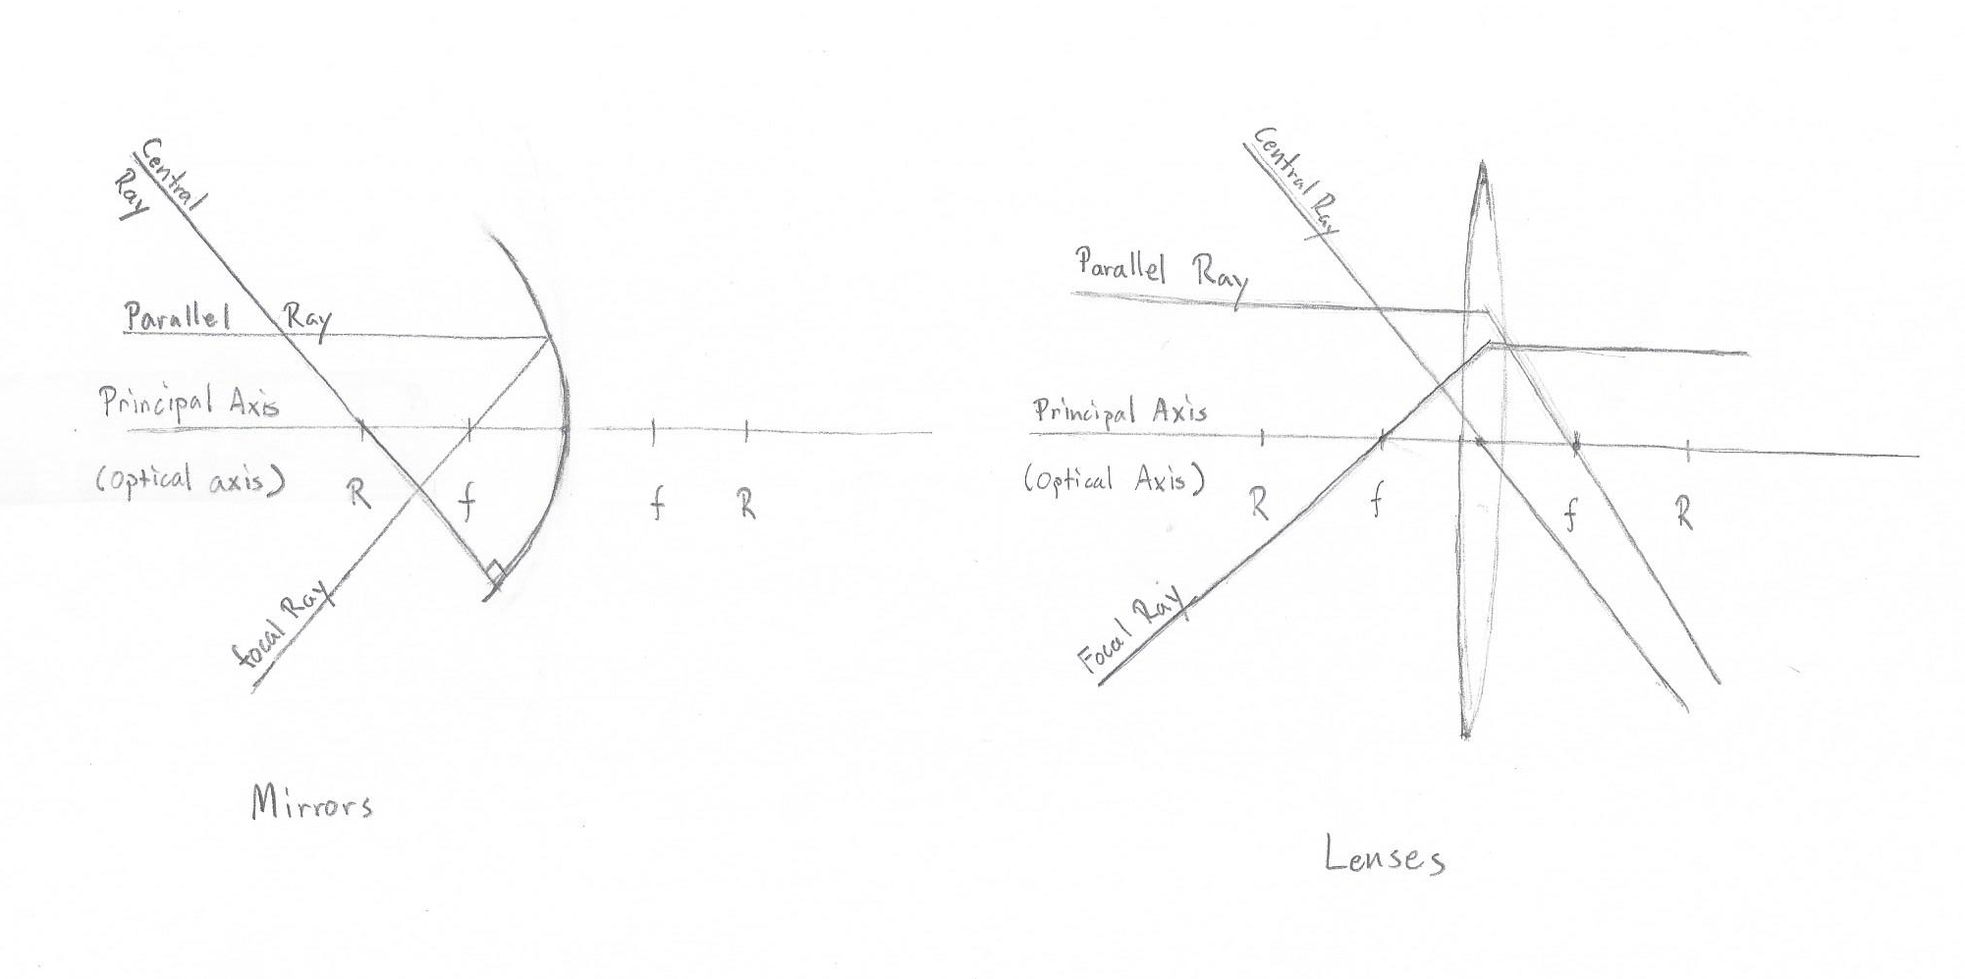
Ray Diagram Terminology

Slide 4
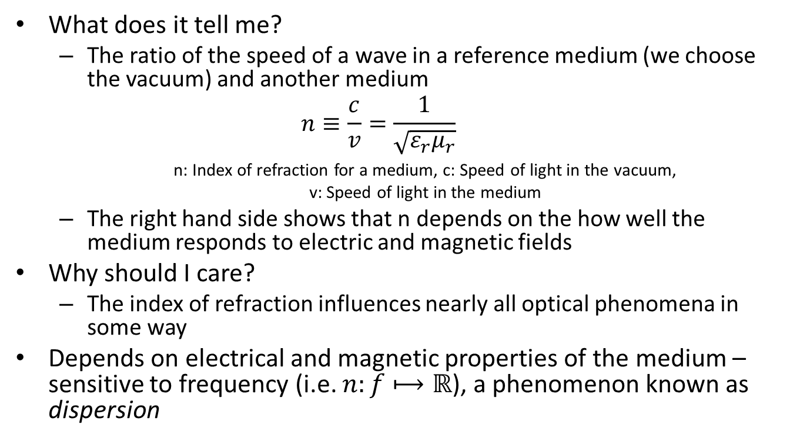
Index of Refraction
What does it tell me?
The ratio of the speed of a wave in a reference medium (we choose the vacuum) and another medium
$$n≡\frac{c}{v}=\frac{1}{\sqrt{ε_{r}μ_{r}}}$$ n: Index of refraction for a medium, c: Speed of light in the vacuum, v: Speed of light in the medium
The right hand side shows that n depends on the how well the medium responds to electric and magnetic fields
Why should I care?
The index of refraction influences nearly all optical phenomena in some way
Depends on electrical and magnetic properties of the medium – sensitive to frequency (i.e. $n:f⟼ℝ$), a phenomenon known as dispersion

Slide 5
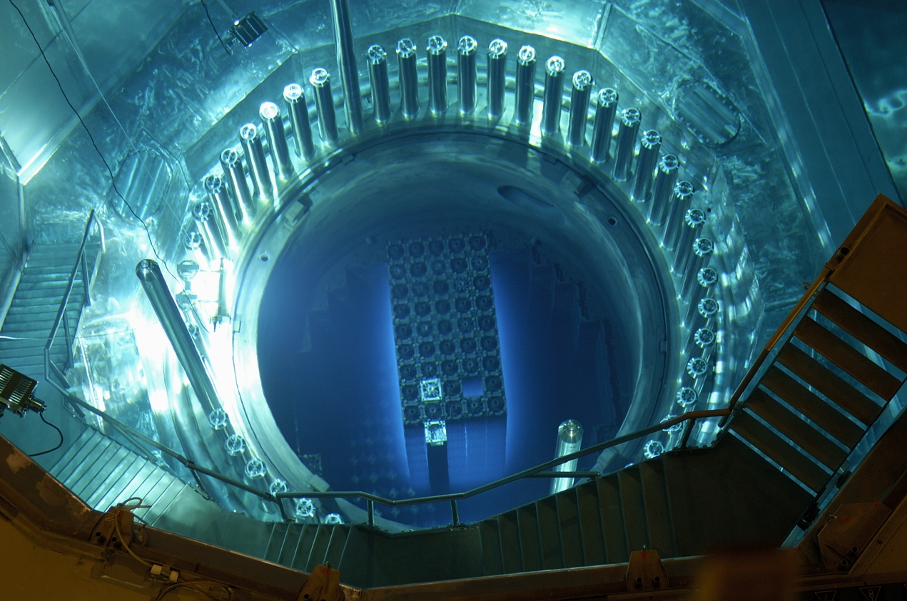
Cherenkov Radiation

Slide 6
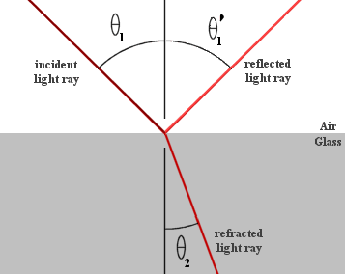
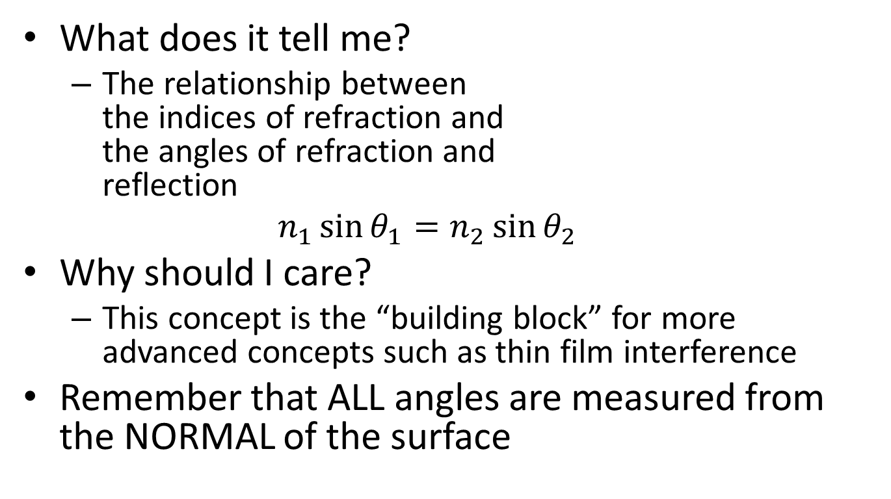
Snell’s Law
What does it tell me?
The relationship between the indices of refraction and the angles of refraction and reflection
$$n_{1}\sin{θ_{1}}=n_{2}\sin{θ_{2}}$$
Why should I care?
This concept is the “building block” for more advanced concepts such as thin film interference
Remember that ALL angles are measured from the NORMAL of the surface

Slide 7
Mirrors & Lenses
The thin lens equation and the mirror equation are identical
The main challenge is observing the proper sign convention
Virtual objects and images always have negative distances
There are complicated tables that tell you based on what type of mirror/lens and the relative position of the object and the focal length whether the image is upright, virtual, etc.
These are unnecessary (and sometimes confusing); A ray diagram or the use of the equations with inequalities can tell you all of this

Slide 8
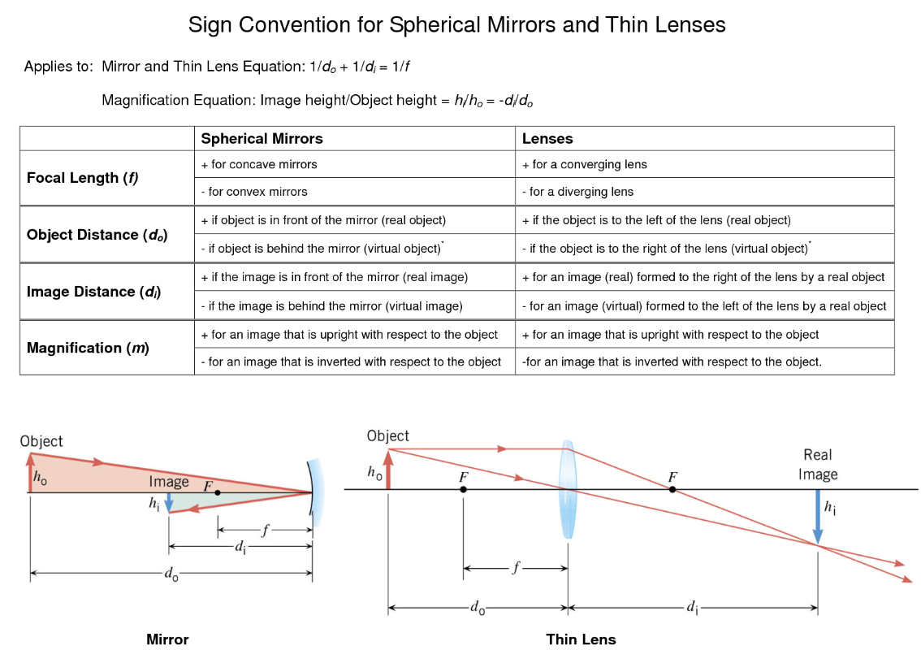
Mirrors & Lenses

Slide 9
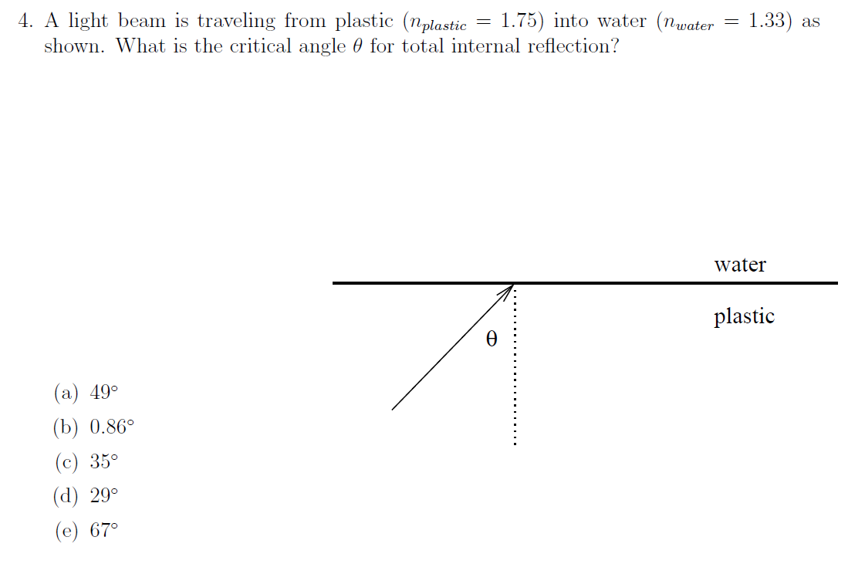
Quiz Question
Notes:
Answer: a

Slide 10
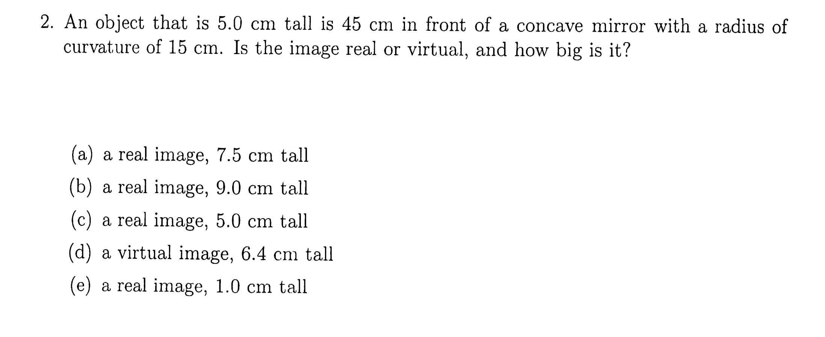
Quiz Question
Notes:
Answer: e

Slide 11
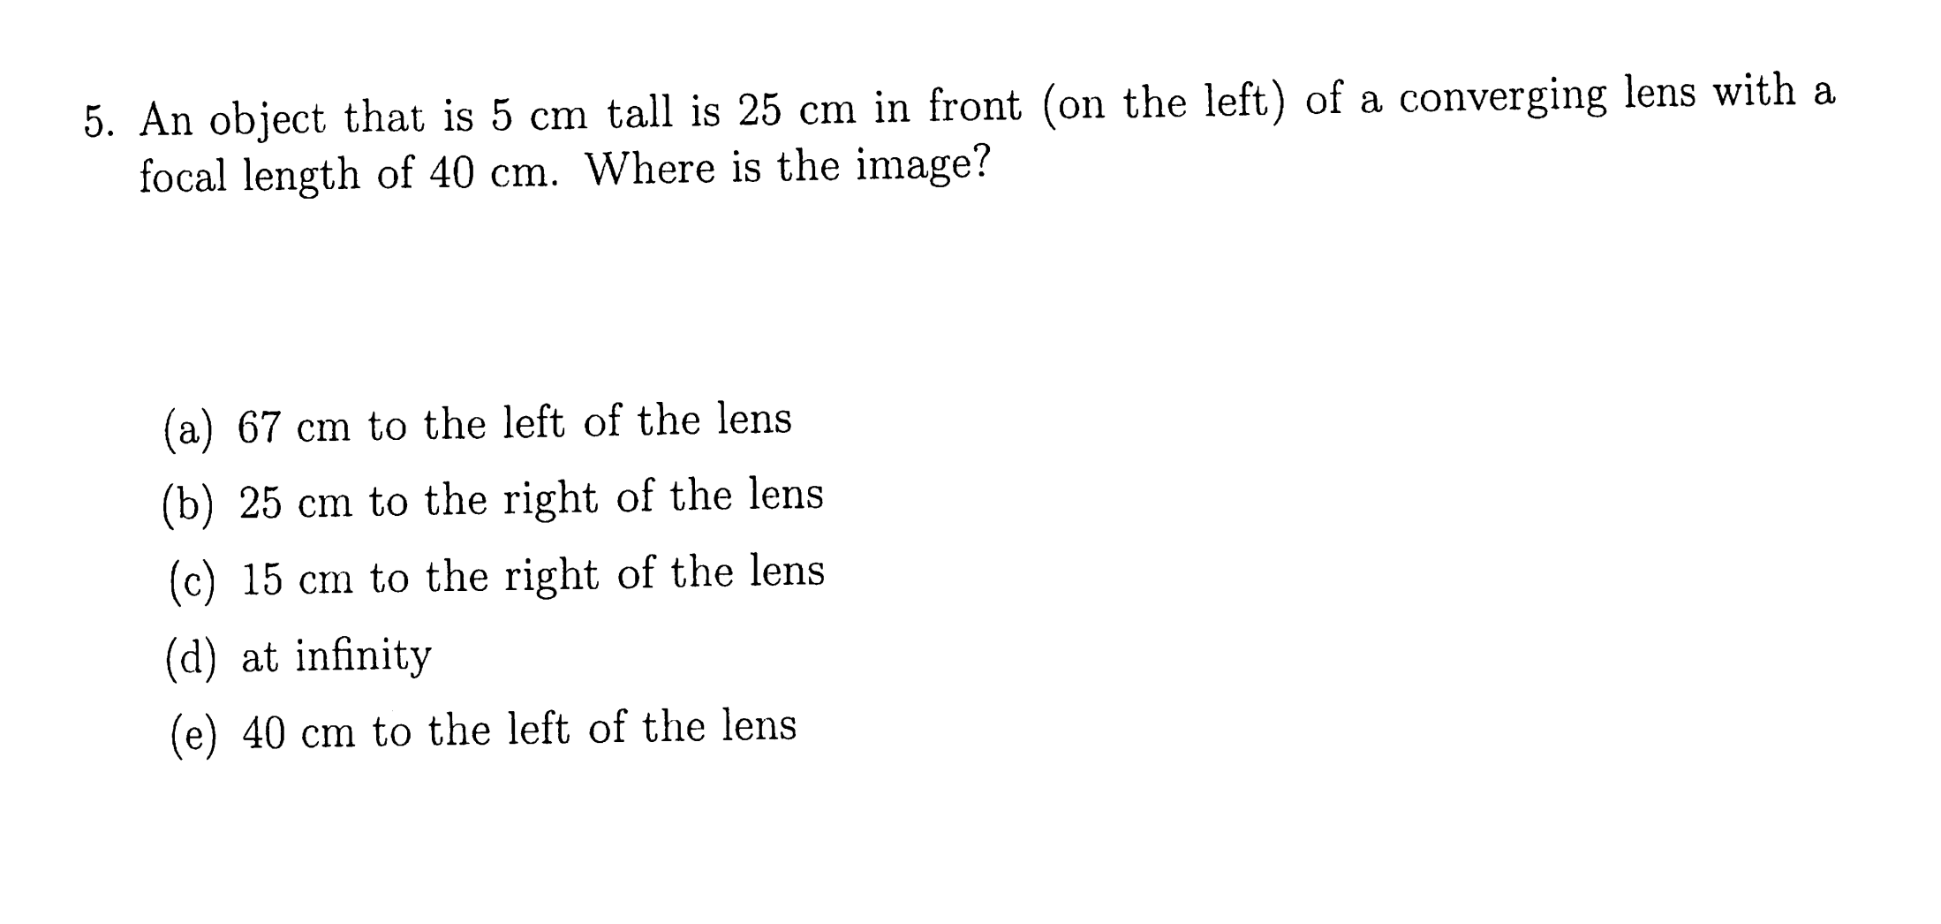
Quiz Question
Notes:
Answer: a

